Slide 1


NEED FOR STUDY
TEAM TECH TITANS:
Ananya B Shetty
Ananya N
Harshitha U
Darshini R
Spoorthi Gowda
Joshwa
Mohammed Zaid
Mohammed Aymaan

Slide 2
NEED FOR STUDY
INTRODUCTION:
TECHNOLOGIES USED:
Our Website NFS, mainly focusses on students attempting to give their best in their academics. We provide quality notes from best of the faculties, well renowned websites like KSEEB and various other websites.
Our “ONE WEBSITE” serves you Textbooks, Notes, Solutions and Model Question Papers for All subjects.
Like the name suggests “NEED FOR STUDY”, we motivate the students to recognize their potential by serving them the Latest Notes and MQP’s and making their life a little bit simpler.
HTML (version: HTML5)
CSS(version:5.3)
Java Script(version:5.3)
BOOTSTRAP(version: Bootstrap 4.6)
GOOGLE CHROME(version: 119.0.6045.159)
VISUAL STUDIO CODE(version:1.84.2)
TARGET AUDIENCE:
Students and Teachers

Slide 3
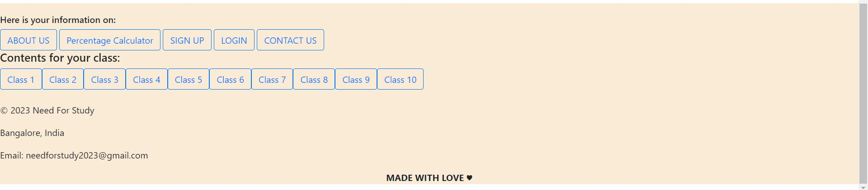
NEED FOR STUDY
NAVIGATION BAR
FOOTER

Slide 4
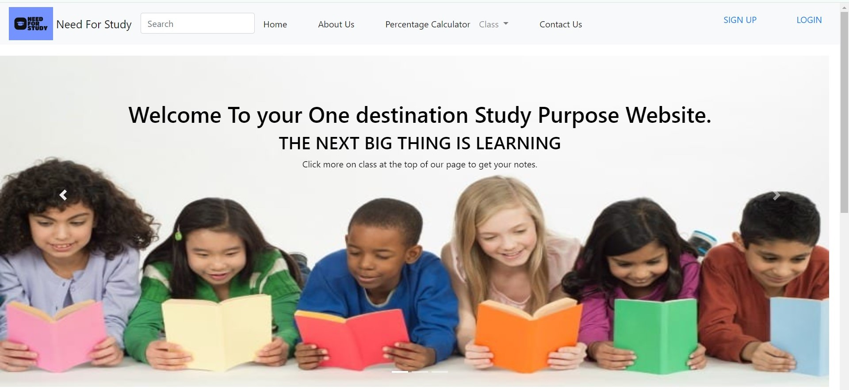
NEED FOR STUDY
CAROUSELS

Slide 5


NEED FOR STUDY
ABOUT US

Slide 6
NEED FOR STUDY
WHAT?
NFS, is a student educational, Go-To Website for all their academic purposes.
HOW?
By serving them notes, textbooks and MQPs.
WHY?
To help students do well in their academics.

Slide 7
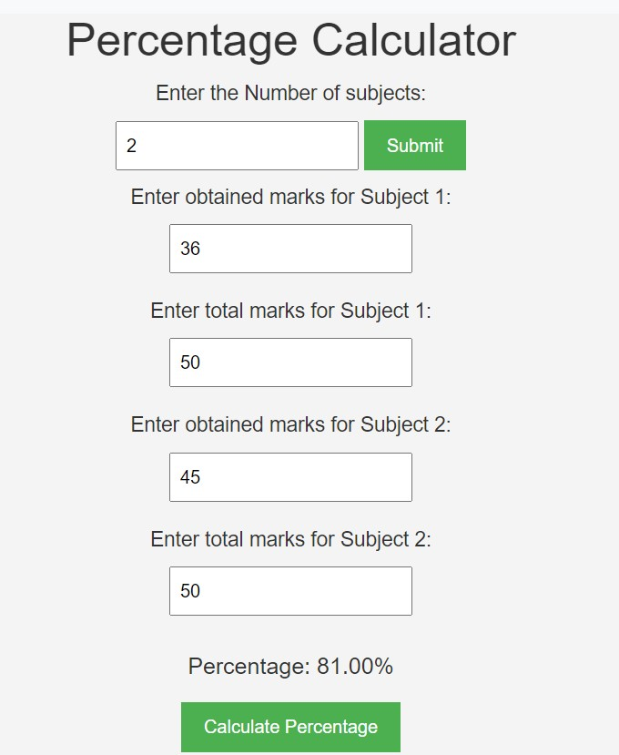
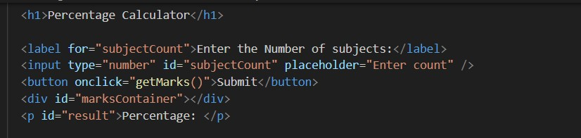
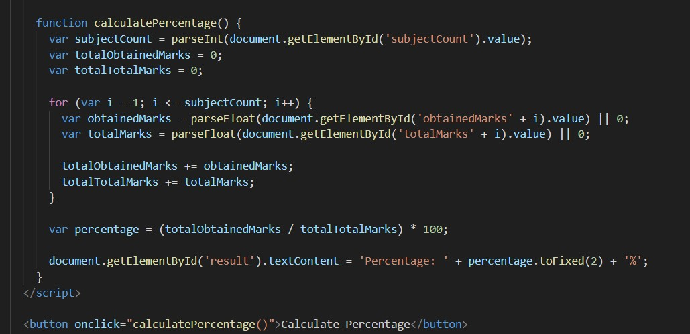
NEED FOR STUDY

Slide 8

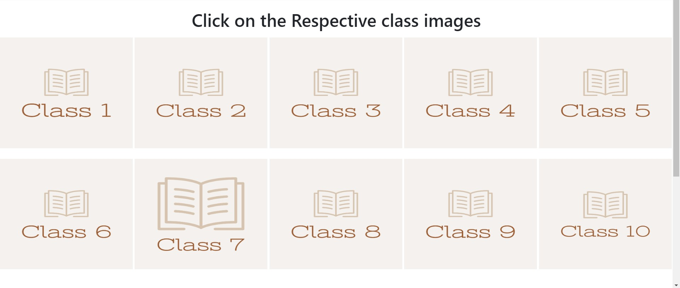
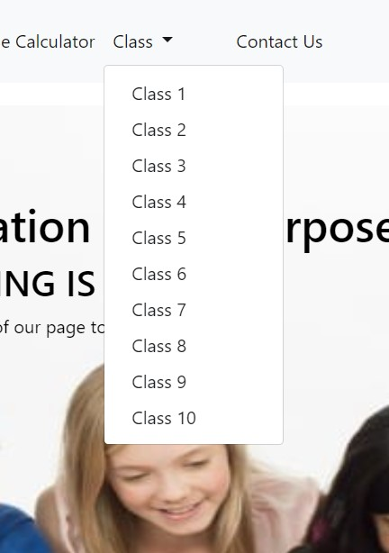
NEED FOR STUDY
CLASSES
NAV BAR

Slide 9
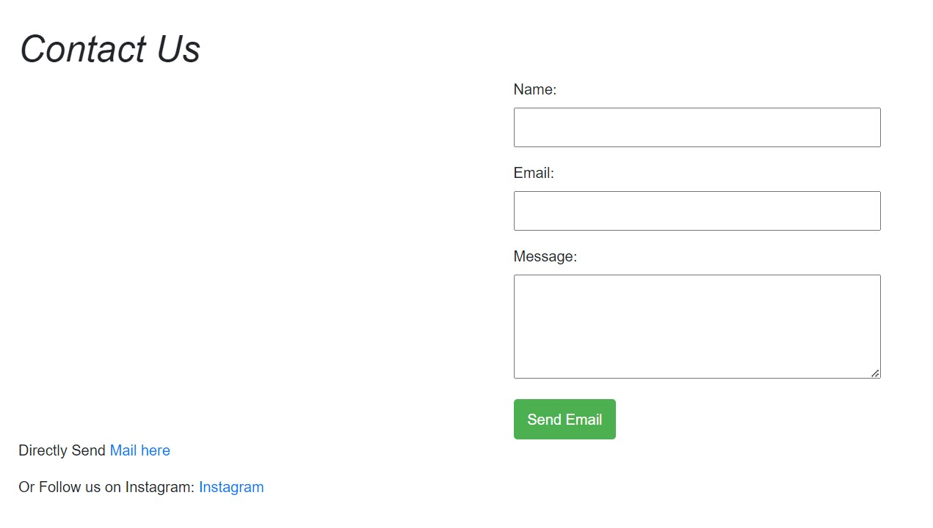
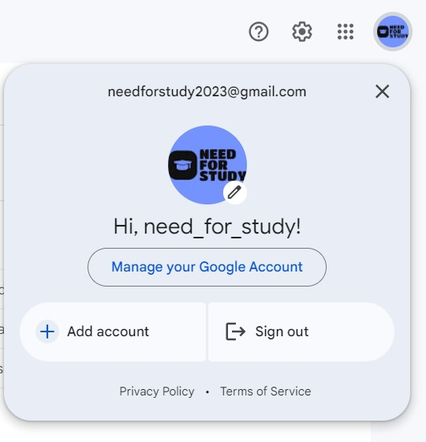
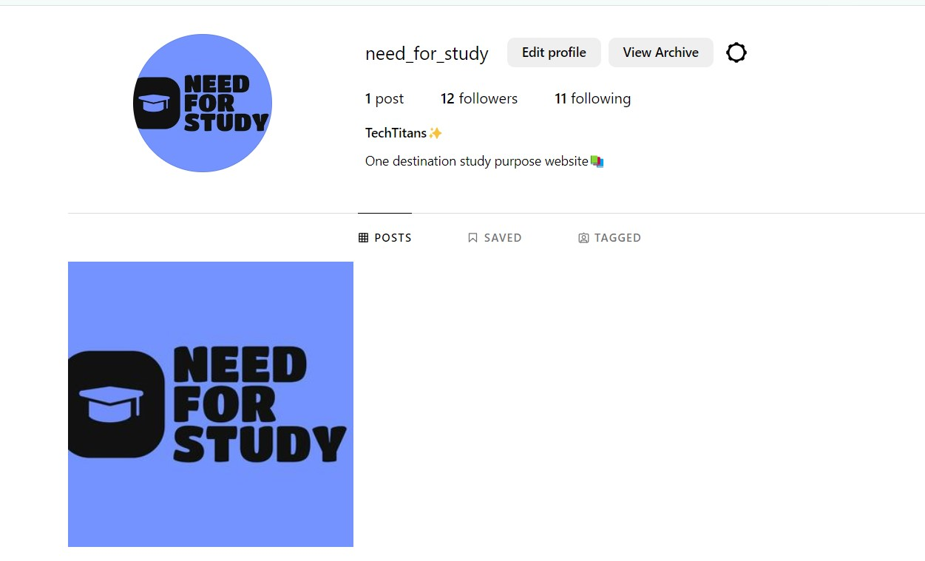
NEED FOR STUDY

Slide 10
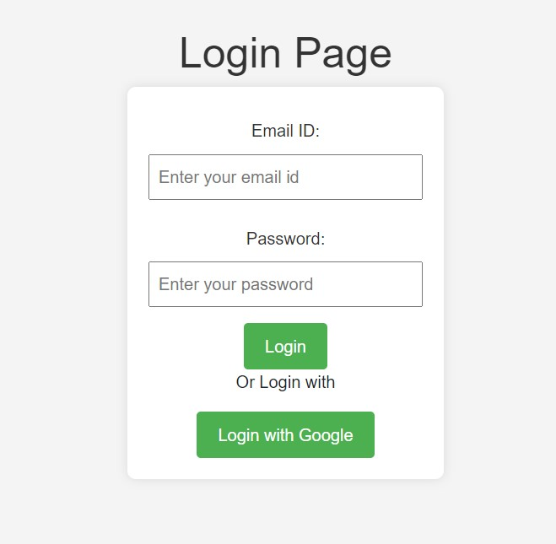
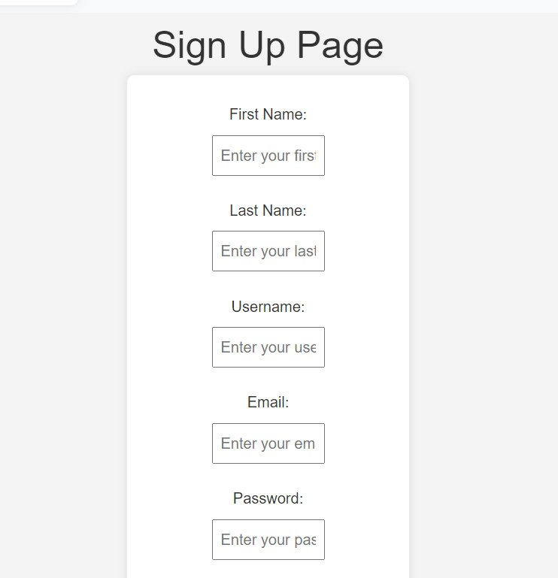
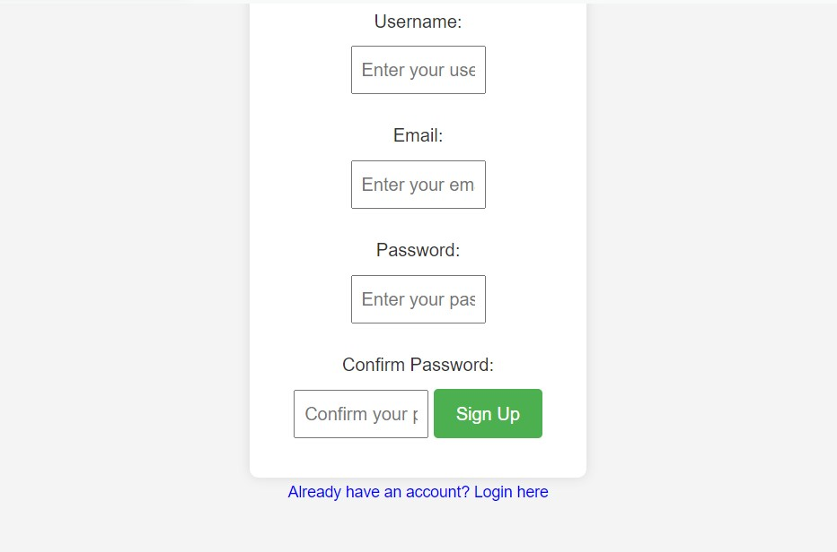
NEED FOR STUDY

Slide 11
NEED FOR STUDY
Our Future Ideas:
To introduce CBSE and ICSE syllabuses.
To create games on Model Question Papers.
To improvise the Notes Section.
To update with all the upcoming schemes and syllabuses for students.
To adding more of creative content and styles using Bootstrap and CSS.
To add Video Tutorials from the best of the faculties.
To upload Podcasts of lesson’s summary.
To upload previous year and mostly asked questions for students above 7th standard.

Slide 12
NEED FOR STUDY
THANK YOU!
By TEAM “Tech Titans”
Questionnaire Time! Let us know If you have any questions❤

